Slide 1
Disclaimer
This training resource was developed to be used with the CZ ID platform
In October, 2026, stewardship of CZ ID transitioned to UCSF and the platform was renamed to SeqtoID
These training materials are not being actively maintained and may not reflect differences between CZ ID and SeqtoID, subsequent changes to the platform, or current methods and best practices in metagenomic sequencing and analysis

Slide 2


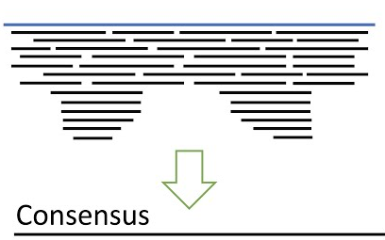



Virus Consensus Genomes

Slide 3
Outline
Consensus genomes
CZ ID’s workflow for generating viral consensus genomes
CZ ID’s assembly report

Slide 4
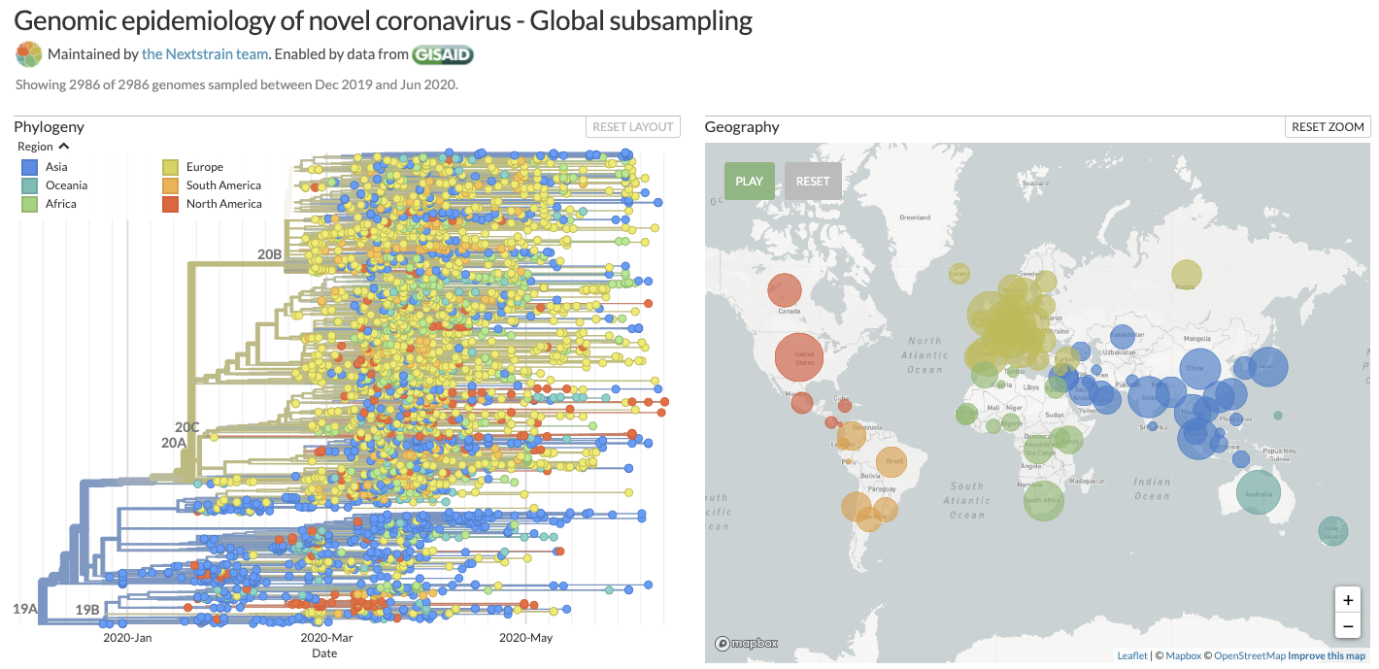
Genome sequences are important! What we sequence are consensus genomes.

Slide 5
Consensus genomes: Represent the most frequently observed nucleotide at each site in the genome at the time of sample collection
ATTGGAGATAC
CTTGCATATAG
ACTGCAGATAG
ATTGCAGATCG
ATTGCTGATAG
ATTGCAGATAG
reads
Reference
Consensus

Slide 6
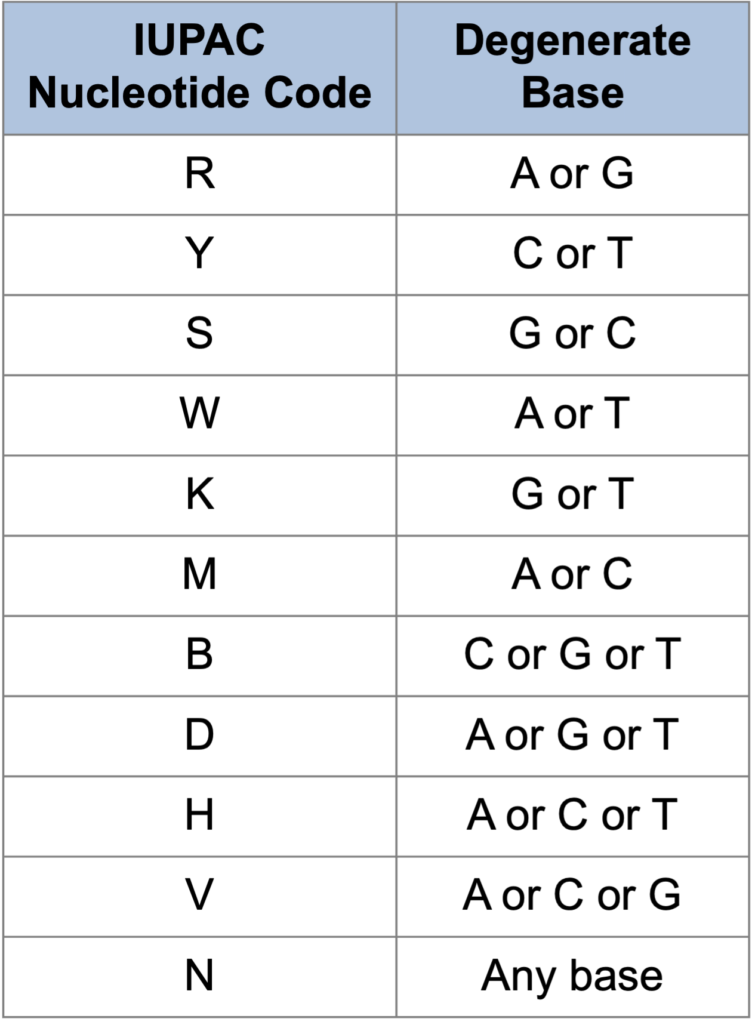
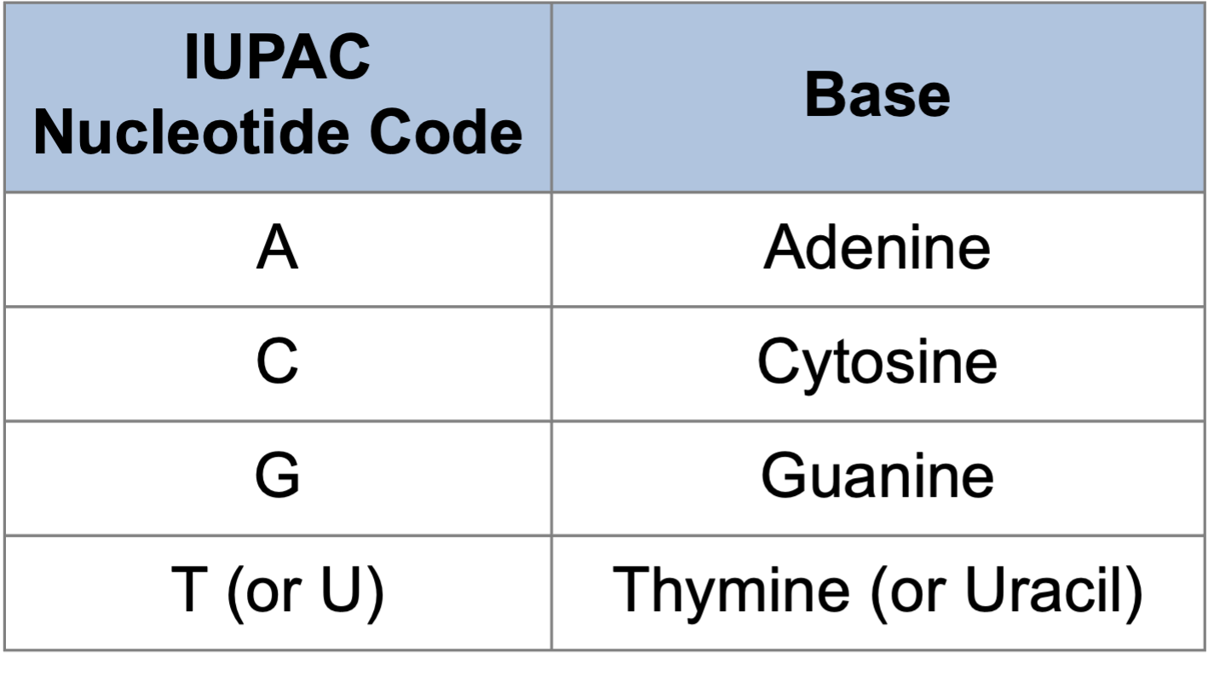
Consensus genomes: Some sites may display high diversity and the majority rule for calling a base cannot be applied. These sites can be defined with the ambiguity code.

Slide 7
Consensus genomes: Some sites may display high diversity and the majority rule for calling a base cannot be applied. These sites can be defined with the ambiguity code.
CTTGGAGATA-G
CTTGCATATA-G
TGTGCAGATACG
TTTGCAGATAGG
ATTGCTGATAGG
YTTGCAGATANG
reads
Reference
Consensus
Ns - considered “missing data”

Slide 8
Workflow for Generating Consensus Genomes
Upload Files
Genome Assembly
Assembly QC
Alignment & Phylogeny
Notes:
Edit to specify read qc and add host removal

Slide 9
Input Files
Sequencing file(s) - Raw sequence reads in FASTQ format
Reference sequence - Reference sequence you would like use to assemble the viral consensus genome by mapping reads against it (FASTA format).
  You should select a reference sequence that is most similar to the genome sequence you are trying to assemble
Primer BED file - File specifying primer positions when using viral sequence data obtained through primer spiking for target enrichment or PCR-based assays. Not required for data obtained through metagenomic sequencing.

Slide 10
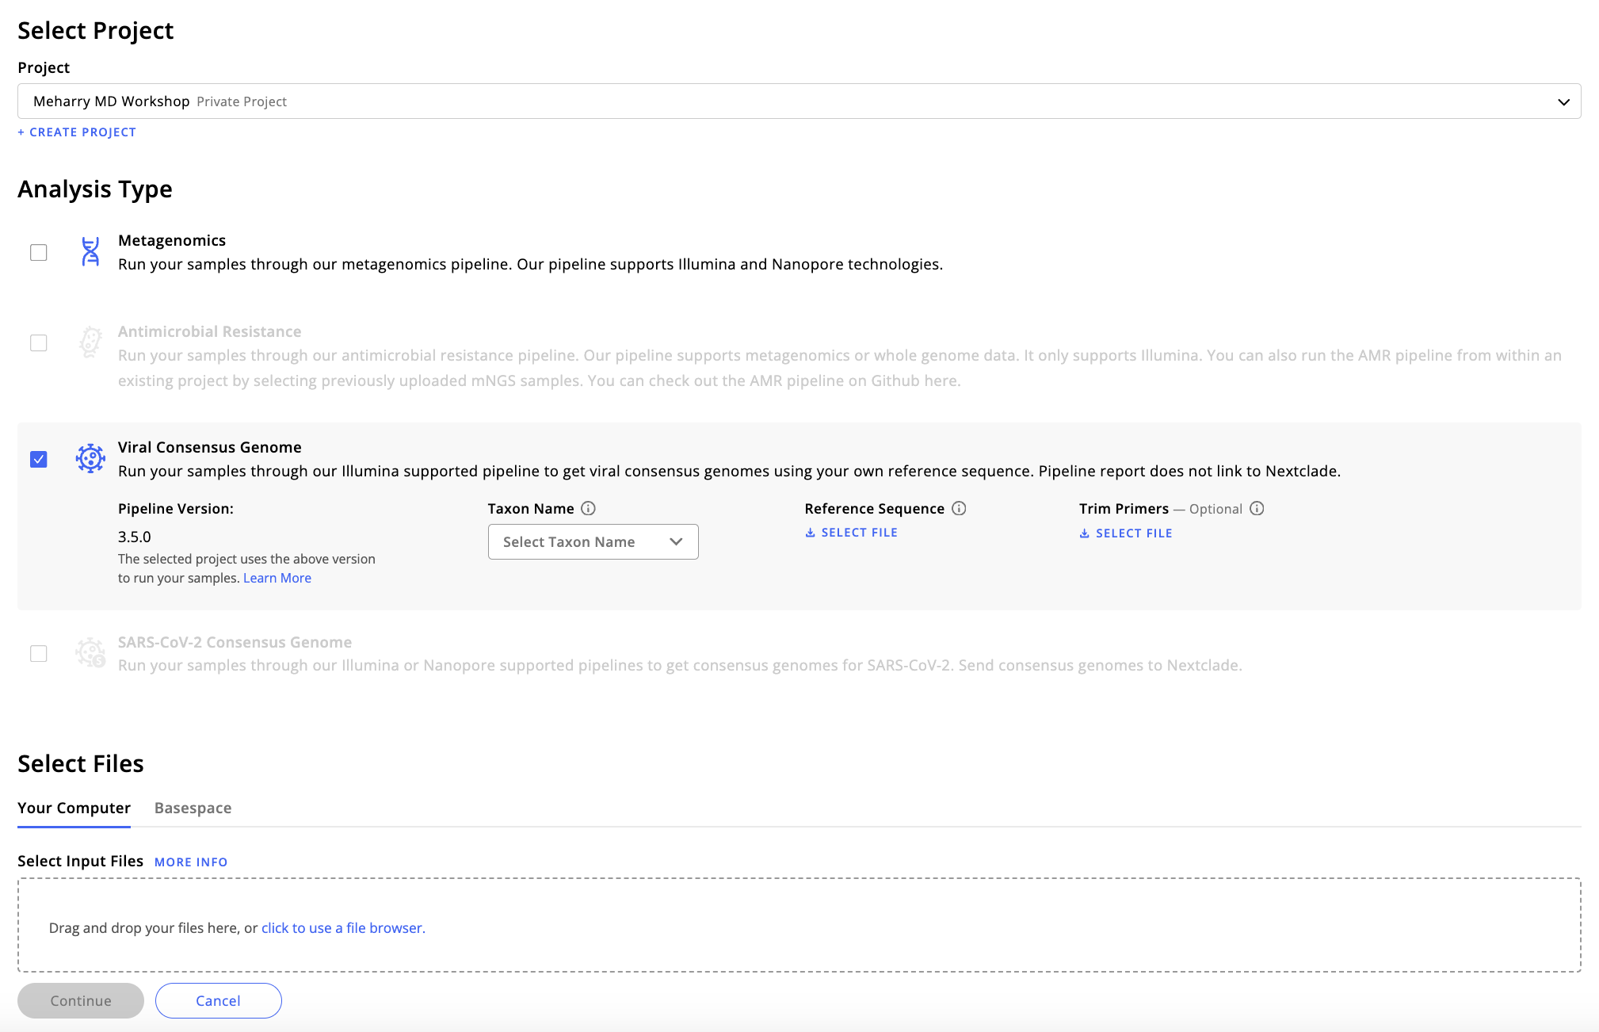

Slide 11
Workflow for Generating Consensus Genomes
Upload Files
Genome Assembly
Assembly QC
Alignment & Phylogeny

Slide 12
Genome Assembly Pipeline
Raw reads
Notes:
Required files
  Raw reads (Illumina FASTQ files)
  Reference sequence (FASTA format)
  BED primer file (Optional)
Reads capped at 50M
Pipeline only removes human host reads
Reads mapped to reference
Validation/ Human Read Removal
Alignment
Trim Primers
SARS-CoV-2 Reference Genome
Consensus Sequence
Call Variants
Call Consensus

Slide 13
Genome Assembly Pipeline
Raw reads
Notes:
Alignment software: minimap2
Mapped reads undergo QC; software: Trim Galore
  Trim low quality bases (<Q20)
  Trim adapters
  Trim short reads (< 20bp)
After QC, remaining reads are remapped to reference (minimap2)
Reads mapped to reference
x
x
x
x
Validation/ Human Read Removal
Alignment/QC/
realignment
Trim Primers
Reference Genome
Consensus Sequence
Call Variants
Call Consensus

Slide 14
Genome Assembly Pipeline
Raw reads
Reads mapped to reference
QC/ Human Read Removal
Alignment
Trim Primers
Reference Genome
Consensus Sequence
Call Variants
Call Consensus
Notes:
Software for trimming primers (soft-clipping): iVar

Slide 15
Genome Assembly Pipeline
Raw reads
Reads mapped to reference
QC/ Human Read Removal
Alignment
Trim Primers
Reference Genome
Consensus Sequence
Call Variants
Call Consensus

Slide 16
Consensus Genome Sequence
Software for calling consensus: iVar
  Minimum depth to call bases:
    Amplicon data (BED file provided): 10 reads
    mNGS data (no BED file): 5 reads
  Quality threshold: Q20
  Frequency threshold: 0.75 (to call a specific base, it should be observed at > 75% frequency)

Slide 17
Genome Assembly Pipeline
Raw reads
Reads mapped to reference
QC/ Human Read Removal
Alignment
Trim Primers
Reference Genome
Consensus Sequence
Call Variants
Call Consensus
Notes:
Variant calling software: BCFtools and samtools

Slide 18
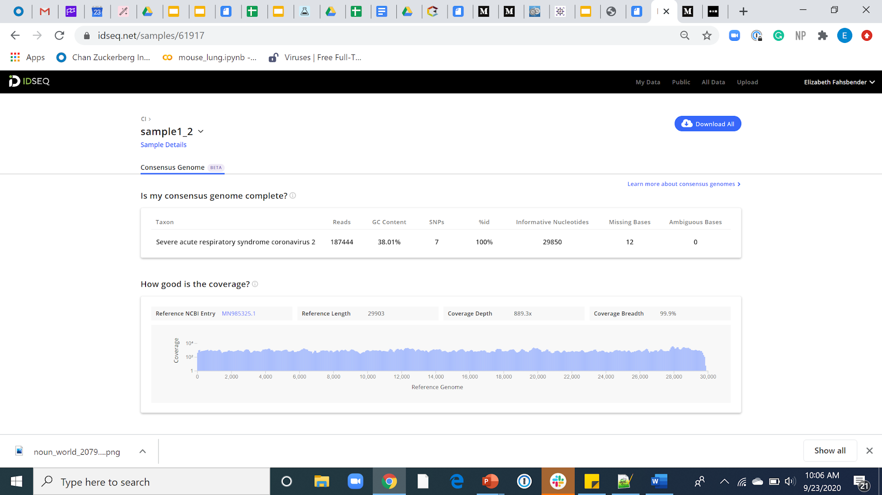
Genome Report

Slide 19
Workflow for Generating Consensus Genomes
Upload Files
Genome Assembly
Assembly QC
Can I use the assembled consensus genome for downstream analyses?
Alignment & Phylogeny

Slide 20
QC Checks
Assembly Metrics
Coverage Stats

Slide 21
Genome QC: Assembly Metrics
Mapped Reads - Number of reads aligning to the reference accession.
GC Content - Percentage of bases in the consensus that are either guanine (G) or cytosine (C) (should be close %GC of the reference sequence).
SNPs (single nucleotide polymorphisms) - Represent single nucleotide variations between the reference accession and consensus genome.
% Identity (id) - Percentage of nucleotides in the consensus genome that are identical to those in the reference accession.

Slide 22
Genome QC: Assembly Metrics (Continued)
Informative Bases - Number of nucleotides that are A,T,C, or G. CZ ID’s consensus genome pipeline only calls nucleotides supported by at least 5 (mNGS data) or 10 (amplicon data) reads.
% Genome Called - Percentage of the genome meeting thresholds for calling consensus bases. The closer this number is to 100%, the better.
Missing Bases - Number of Ns in the consensus genome.
Ambiguous Bases - Number of degenerate bases (non-C, T, G, or A) in the consensus genome. CZ ID’s consensus genome pipeline only calls nucleotides that are detected at least at 75% frequency.

Slide 23

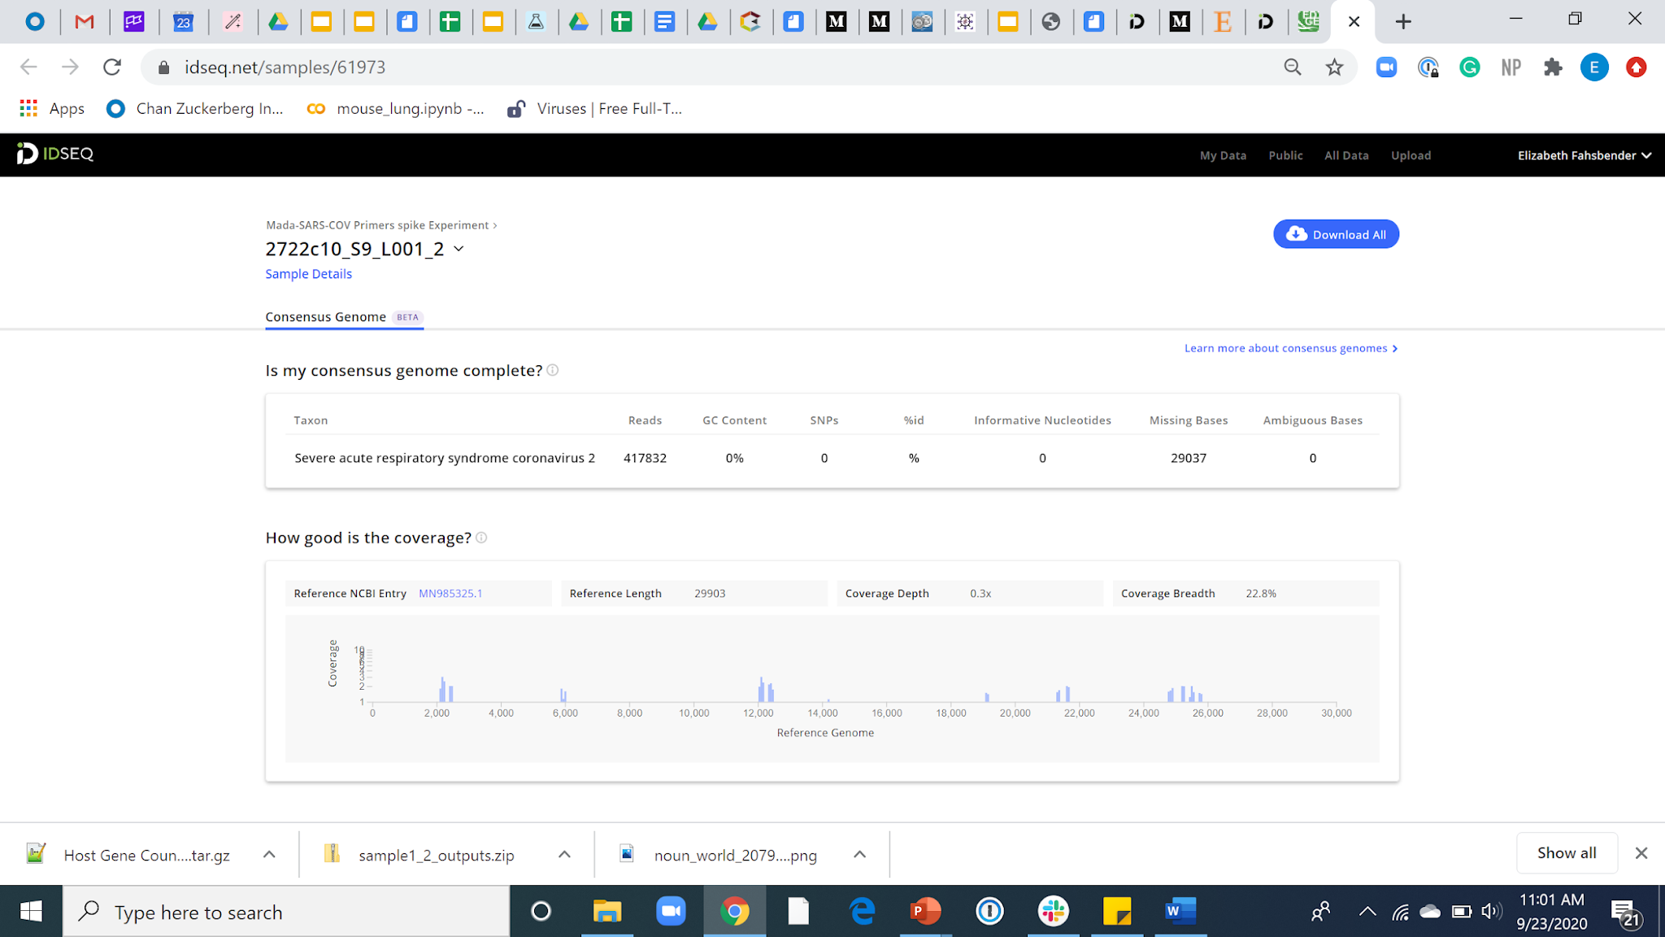
The coverage plot is a great first QC check
Reads Aligned to Reference
Reads Aligned to Reference

Slide 24
The coverage plot is a great first QC check
Reads Aligned to Reference
Reads Aligned to Reference

Slide 25
Is there enough coverage depth?
More depth
No coverage
Less depth
Raw Reads Aligned to Reference
Reference Genome
Coverage Depth: # of times a nucleotide is read during sequencing

Slide 26
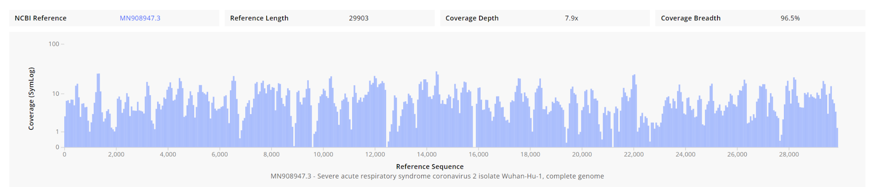
Coverage Depth Matters
For WGS data, any area with coverage of < 10 reads will be called an N in the consensus genome (< 5 reads will be called an N for the mNGS consensus pipeline)
The consensus genome below would have poor quality
(most base calls would be Ns)

Slide 27
Was most of the genome recovered (coverage breadth)?
Raw Reads Aligned to Reference
Reference Genome
Consensus Sequence
NNNN
Partially recovered genomes are less useful for phylogenetics
Coverage Breadth: Percentage of reference sequence that is covered
Gap
Notes:
Option: fill gaps with reference sequence

Slide 28
Evaluating Coverage to Identify SNPs
Raw Reads Aligned to Reference
Reference Genome
C
A
G
C
?
Consensus Sequence
SNPs: Single Nucleotide Polymorphisms, variations in a single base pair in a DNA sequence. The number of acceptable SNPs is pathogen dependent

Slide 29
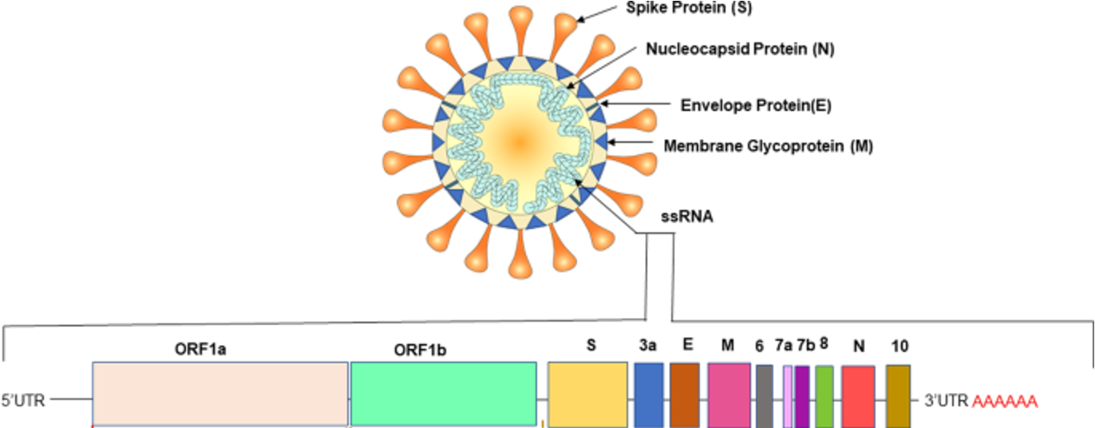
What’s next?
Does the genome include predicted coding regions?
  Find open reading frames (ORFs) and compare to known genomes
Rastogi et. al., 2020

Slide 30
What’s next?
Does the genome include predicted coding regions?
  Find open reading frames (ORFs) and compare to known genomes
Which serotype or variant does it represent?
  Use available typing tools to determine the virus serotype or lineage
Nextclade - SARS-CoV-2, Influenza (Flu), Mpox (Monkeypox), Respiratory Syncytial Virus (RSV)
Genome Detective - Arboviruses, hepatitis viruses, enteroviruses, measles virus
Phylogenetic analysis

